Slide 1
Chapter 7 Inference for Distributions
7.1 Inference for the Mean of a Population
7.2 Comparing Two Means
7.3 Other Topics in Comparing Distributions

Slide 2
7.1 Inference for the Mean of a Population
The t distributions
One-sample t confidence interval
One-sample t test
Matched pairs t procedures
Robustness of the t procedures

Slide 3
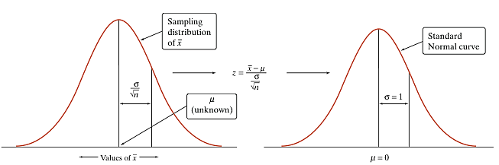
The t Distributions
When the sampling distribution of is close to Normal, we can find probabilities involving by standardizing:
When we don’t know σ, we can estimate it using the sample standard deviation s_{x}. What happens when we standardize?
This new statistic does not have a Normal distribution!

Slide 4
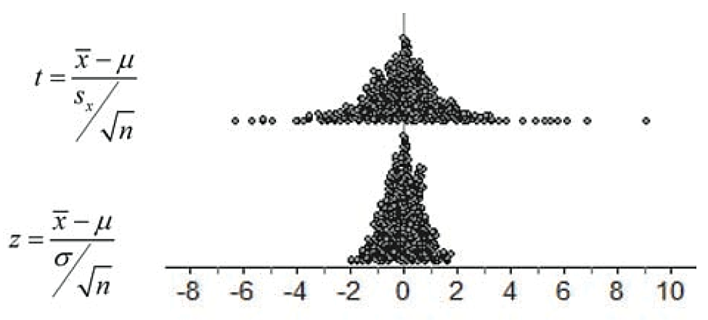
The t Distributions
When we standardize based on the sample standard deviation s_{x}, our statistic has a new distribution called a t distribution.
The t distribution has a shape similar to that of the standard Normal curve in that it is symmetric with a single peak at 0.
However, it differs from the Normal curve in that it has more area in the tails.
However, there is a different t distribution for each sample size, specified by its degrees of freedom (df).

Slide 5
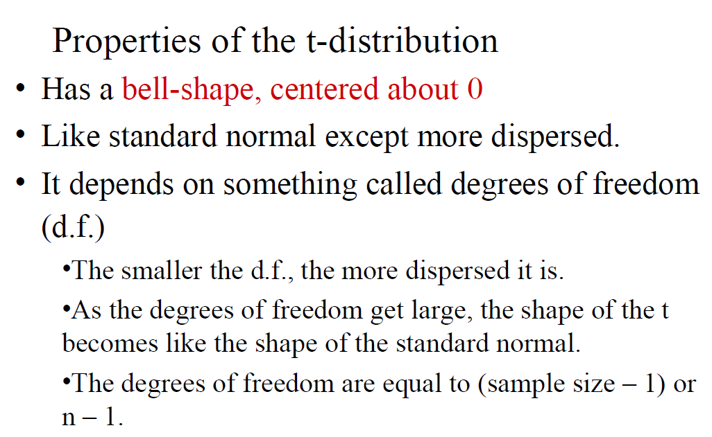
The t Distributions
When we perform inference about a population mean µ using a t distribution, the appropriate degrees of freedom are found by subtracting 1 from the sample size n, making df = n – 1.
The t Distributions: Degrees of Freedom
Draw an SRS of size n from a large population that has a Normal distribution with mean µ and standard deviation σ. The one-sample t statistic
has the t distribution with degrees of freedom df = n – 1.

Slide 6
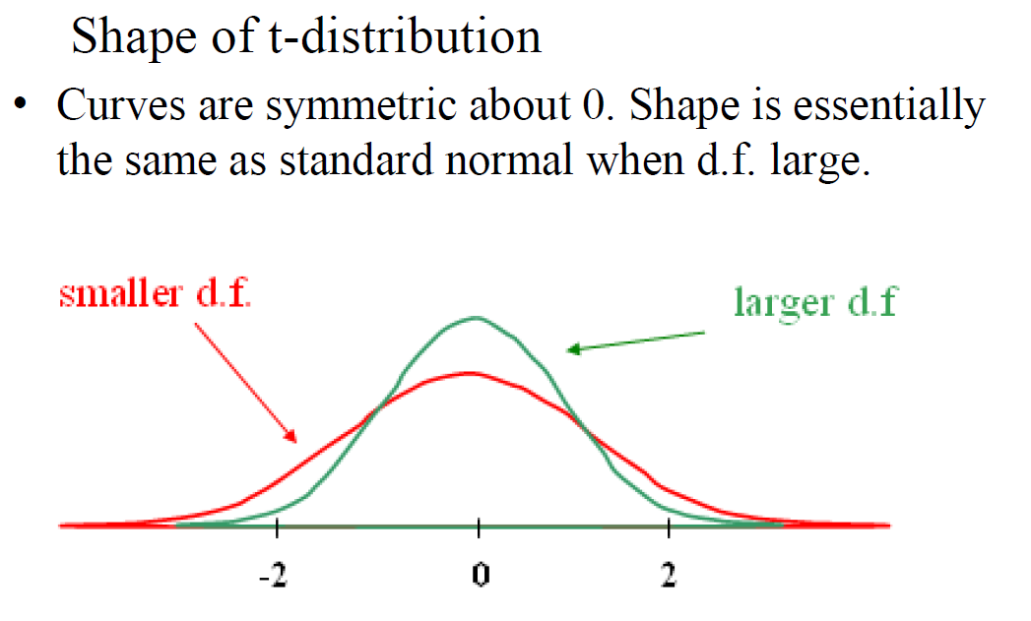

Slide 7
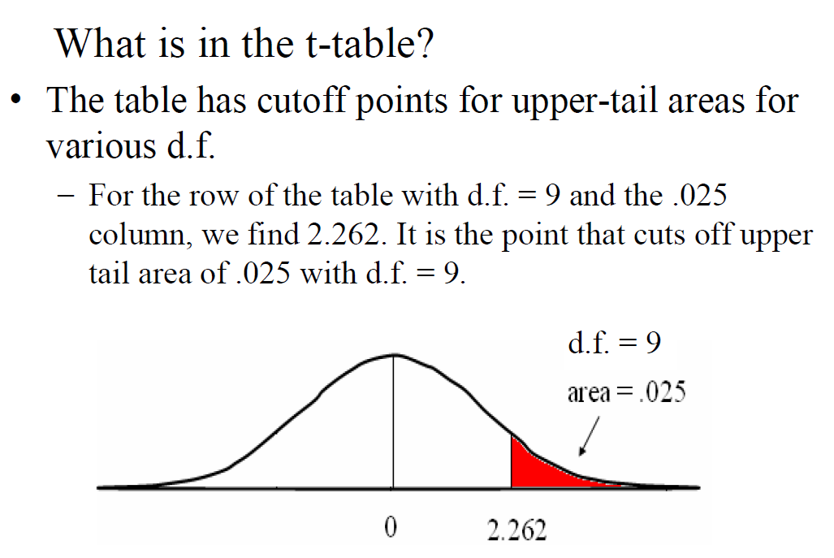
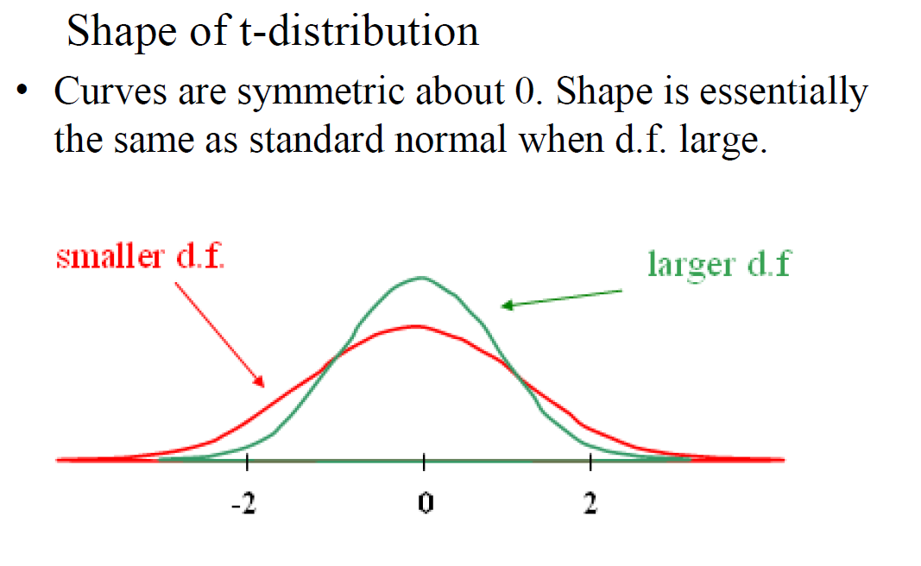
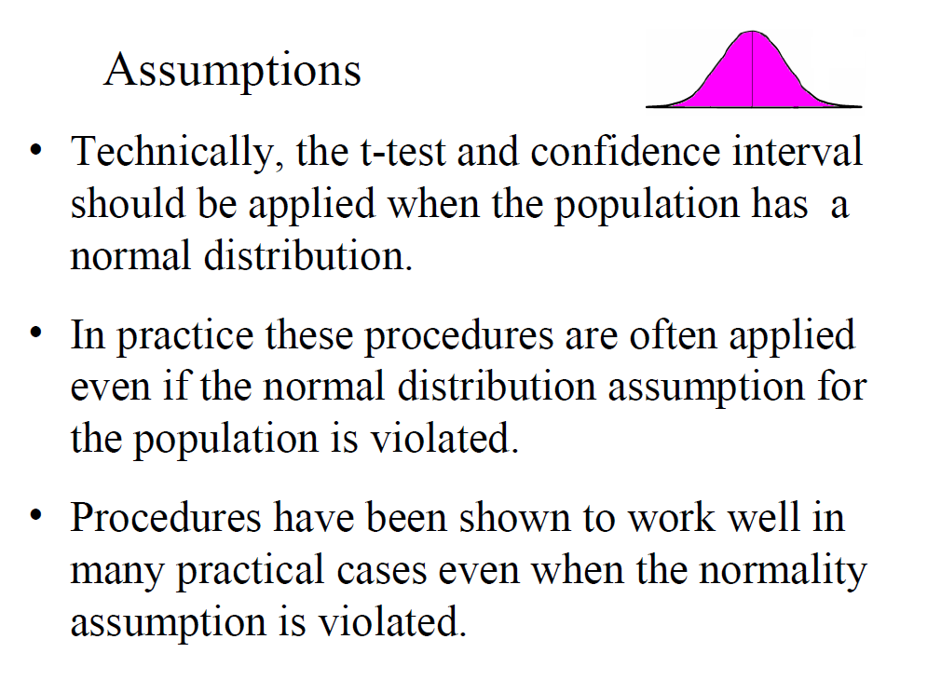

Slide 8
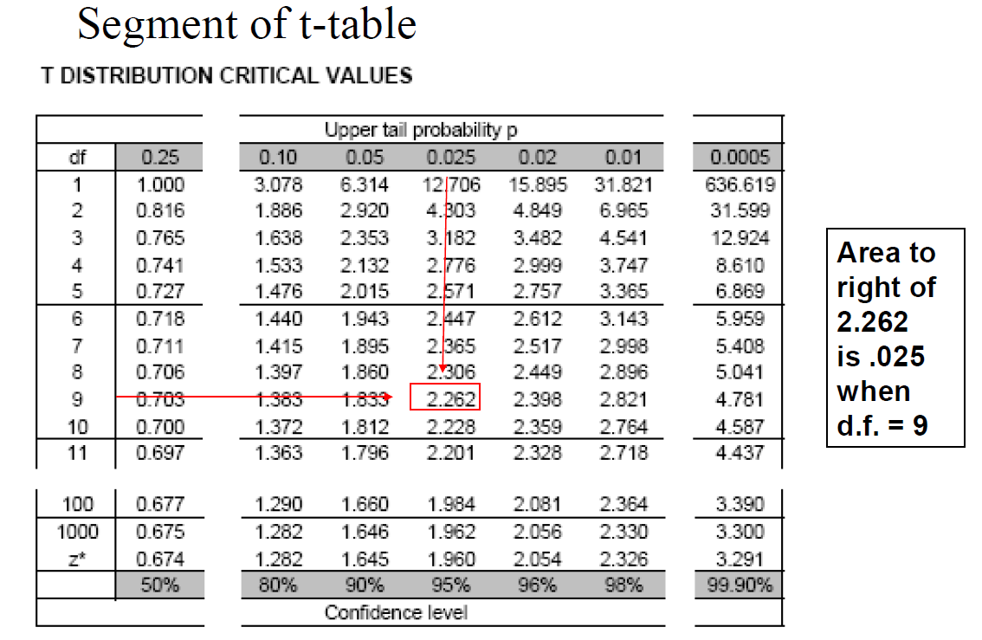

Slide 9
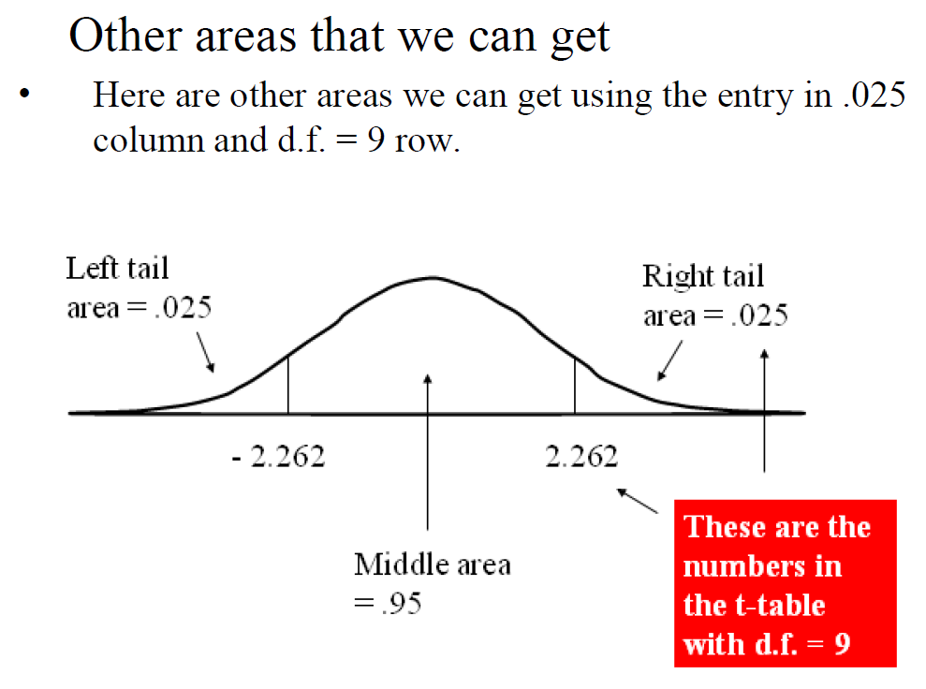

Slide 10
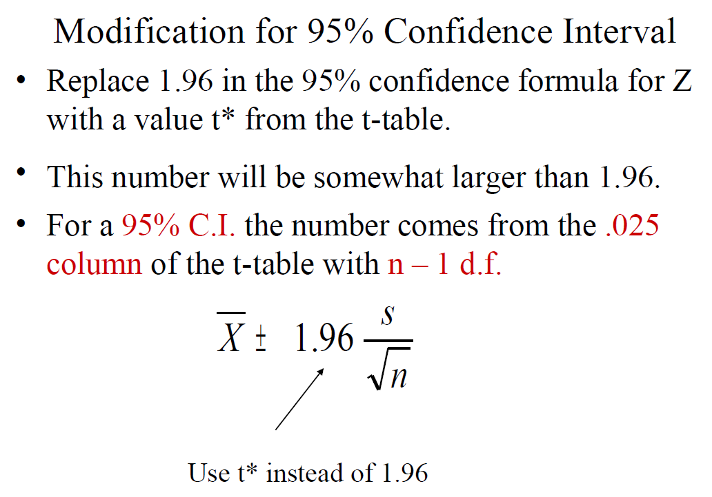

Slide 11
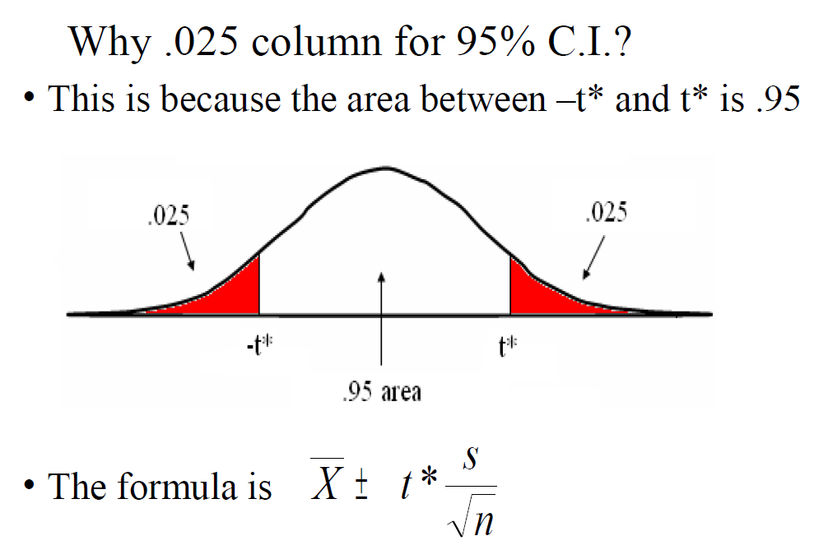

Slide 12
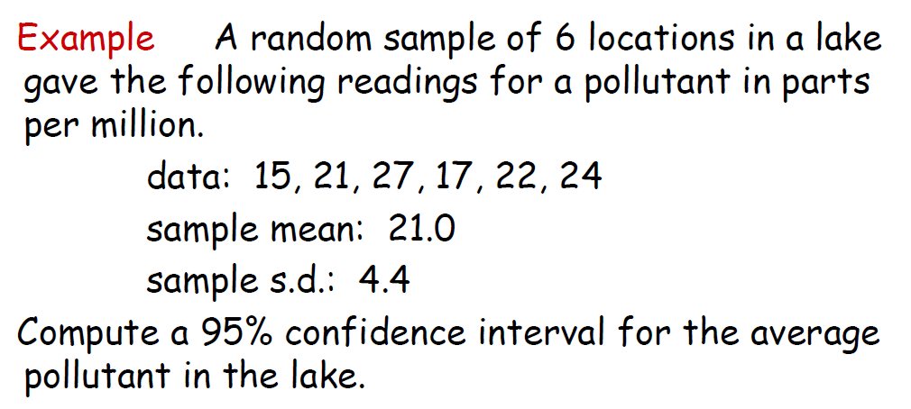

Slide 13
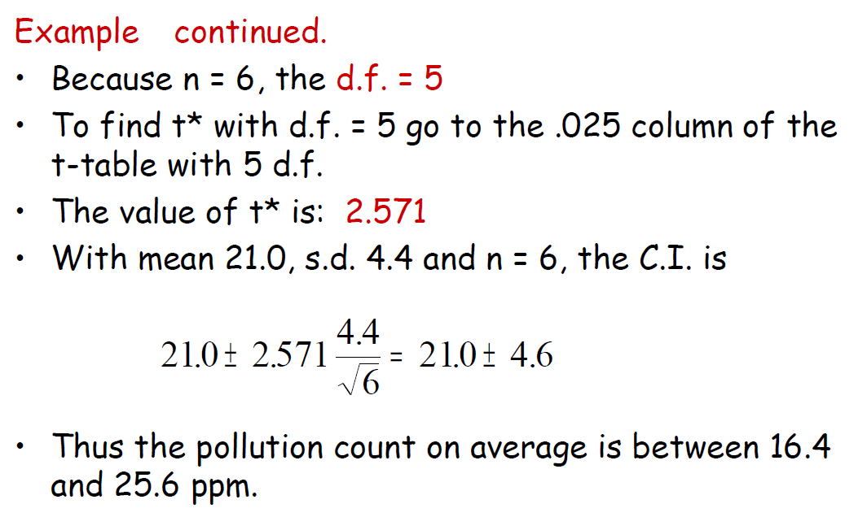

Slide 14
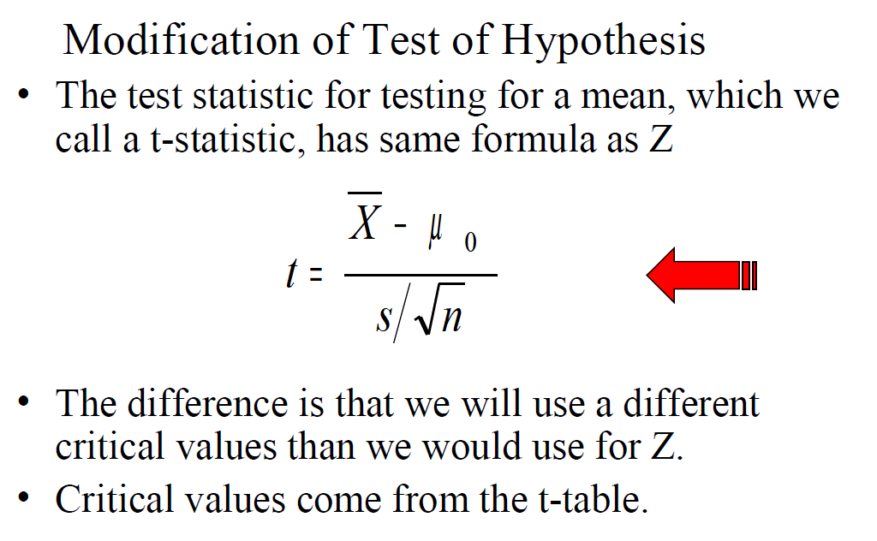

Slide 15
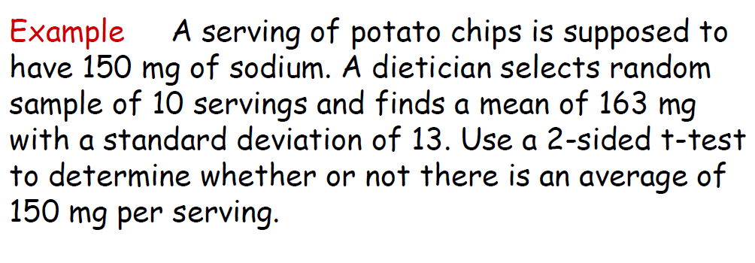

Slide 16
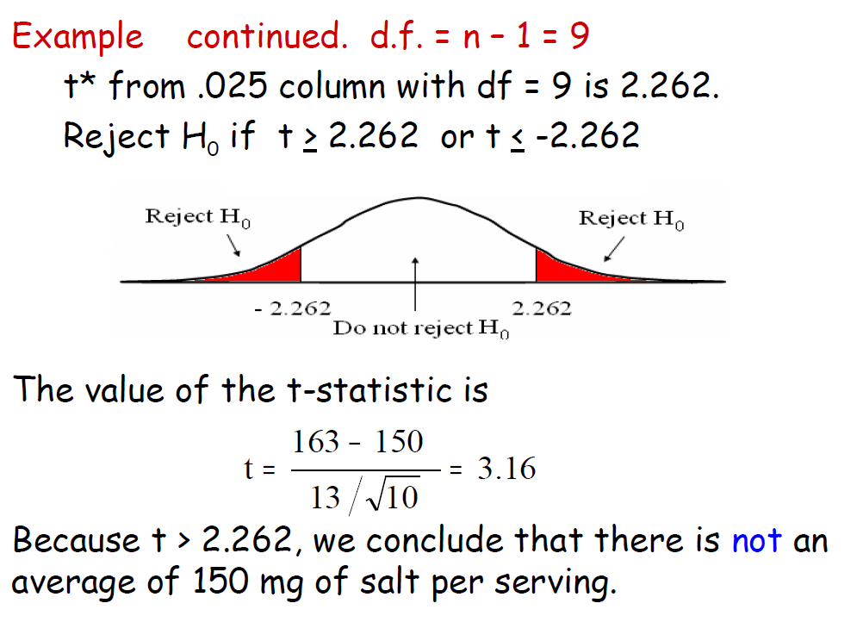

Slide 17
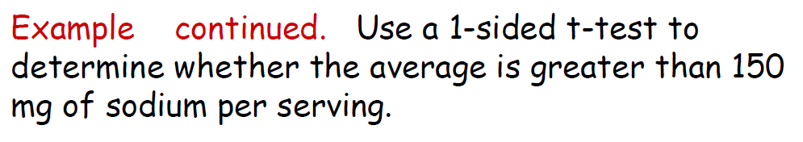

Slide 18
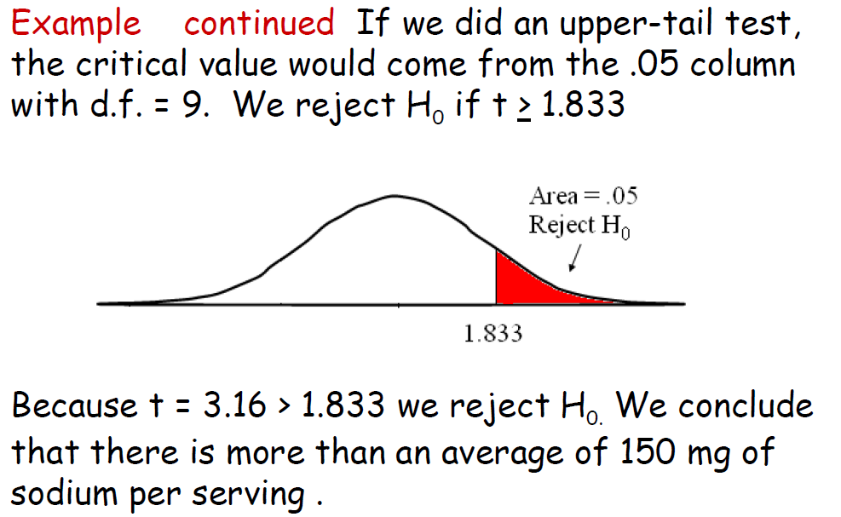

Slide 19
Example
The Nielsen Company states that adults age 18 to 24 years old average 18.5 hours per week watching traditional television. Does this average seem reasonable for college students? We drew an SRS of eight college students and obtained the following data, in hours of TV watched per week:
3.0, 16.5, 10.5, 40.5, 5.5, 33.5, 0.0, 6.5
We want to estimate the true mean hours of television watched per week, µ, of all college students with a 95% confidence level.

Slide 20
Example
Recall for the earlier television watching example that the Nielson Company reported an average of 18.5 hours for 18 to 24 year olds. We want to test whether the average time that college students watch television differs from the reported value of 18.5.
We want to perform a test at the α = 0.05 significance level of
H₀: µ = 18.5
H_{a}: µ ≠ 18.5
where µ is the actual mean hours of television watched by college students.
Earlier, we checked that the conditions for inference were satisfied, so we can proceed to the t test.

Slide 21
Example
We have calculated the mean and standard deviation of the eight students in the sample.
Because n = 8, we use the t distribution with df = 7 to find the critical value.
Upper-tail probability p
df | .05 | .025 | .02
6 | 1.943 | 2.447 | 2.612
7 | 1.895 | 2.365 | 2.517
8 | 1.860 | 2.306 | 2.449
 | 90% | 95% | 96%
 | Confidence level C
From Table D, we find t* = 2.365.
Therefore, the 95% confidence interval for µ is
We are 95% confident that the interval from 2.08 to 26.92 hours captures the true mean time spent watching television by college students.

Slide 22
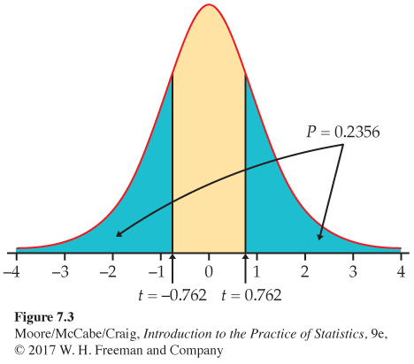
Example
The sample mean and standard deviation are
P-value The P-value is twice the area to the left of t = –0.76 under the t distribution curve with df = 8 – 1 = 7.
The P-value is between 2 x 0.20 = 0.40 and 2 x 0.25 = 0.50. Because this is greater than our α = 0.05 significance level, we fail to reject H₀. We don’t have enough evidence to conclude that the mean hours college students watch television differs from the Nielsen value of 18.5.
Upper-tail probability p
df | .25 | .20 | .15
6 | 0.718 | 0.906 | 1.134
7 | 0.711 | 0.896 | 1.119
8 | 0.706 | 0.889 | 1.108
 | 50% | 60% | 70%
 | Confidence level C

Slide 23
Matched Pairs t Procedures
Comparative studies are more convincing than single-sample investigations. For that reason, one-sample inference is less common than comparative inference. Study designs that involve making two observations on the same individual, or one observation on each of two similar individuals, result in paired data.
When paired data result from measuring the same quantitative variable twice, as in the job satisfaction study, we can make comparisons by analyzing the differences in each pair. If the conditions for inference are met, we can use one-sample t procedures to perform inference about the mean difference µ_{d}.
Matched Pairs t Procedures
To compare the responses to the two treatments in a matched pairs design, find the difference between the responses within each pair. Then apply the one-sample t procedures to these differences.

Slide 24
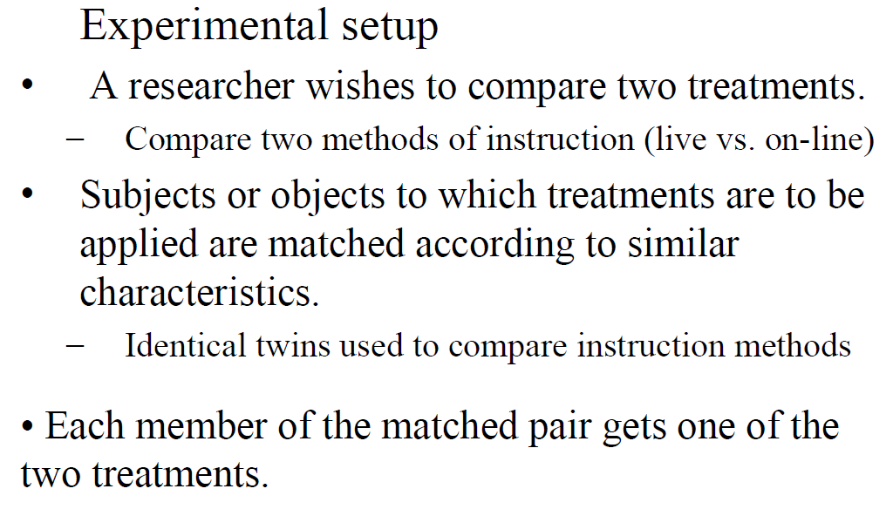

Slide 25
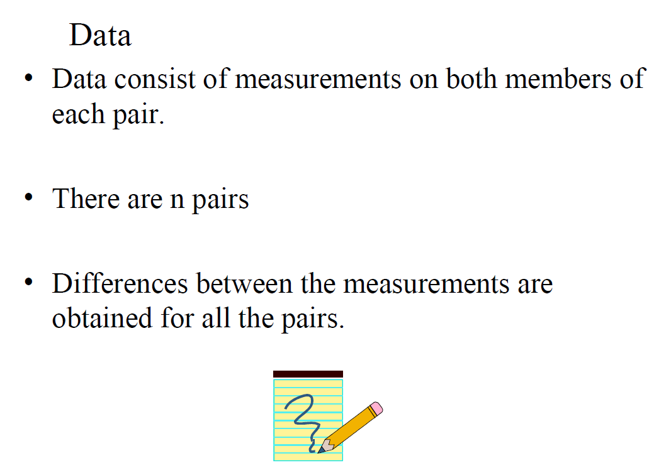

Slide 26
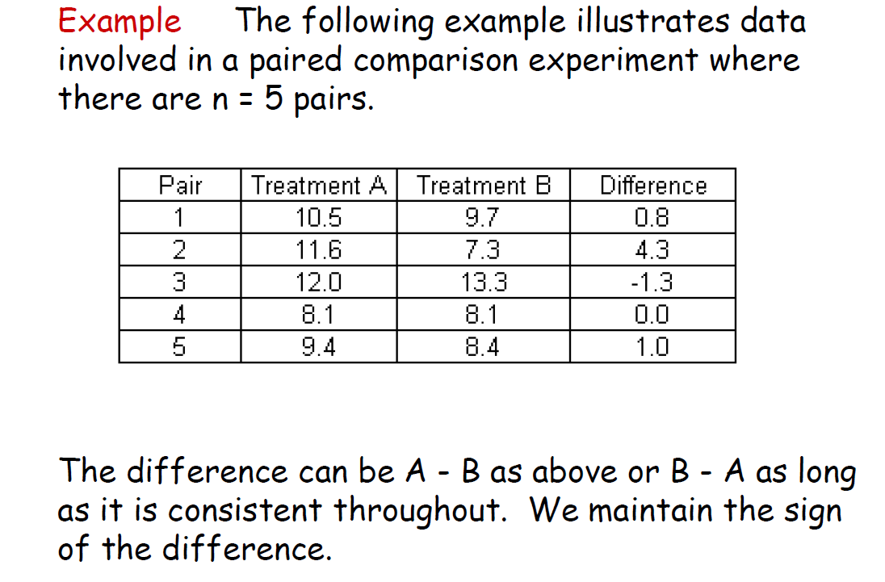

Slide 27
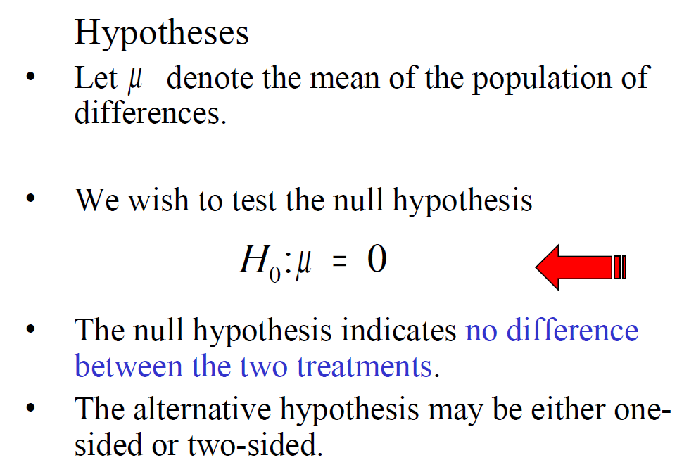

Slide 28
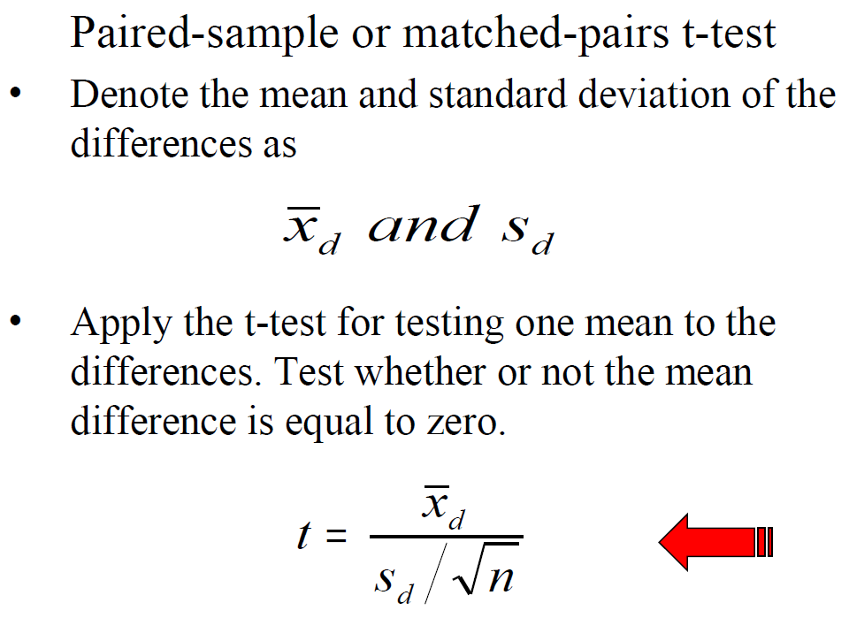

Slide 29
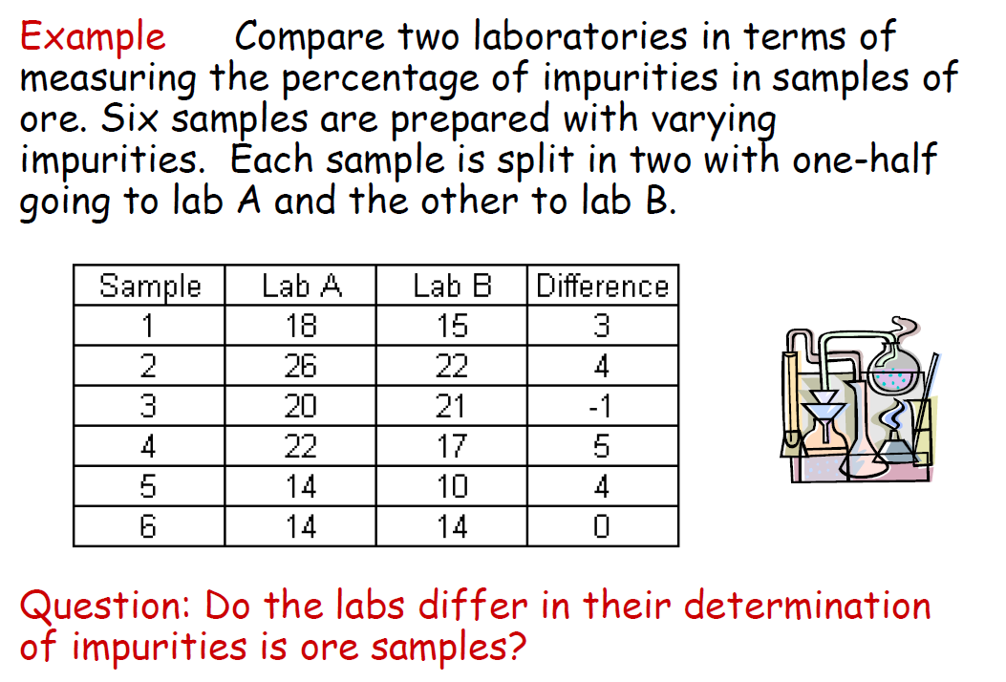

Slide 30
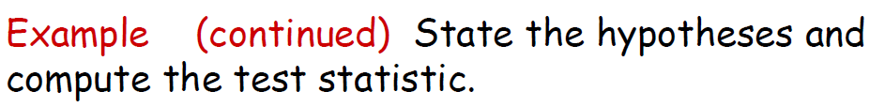

Slide 31
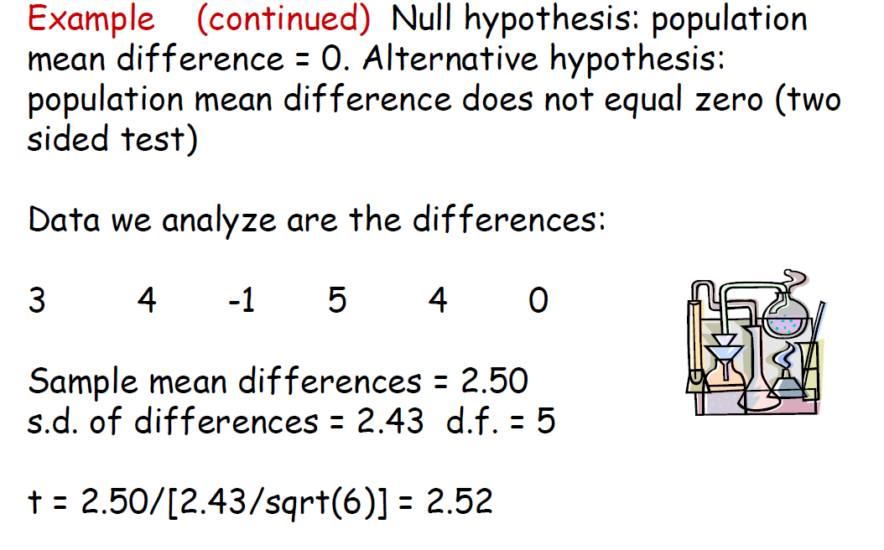

Slide 32
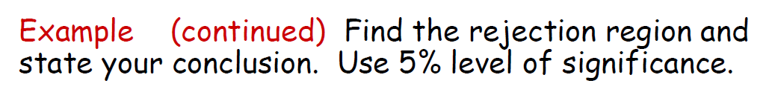

Slide 33
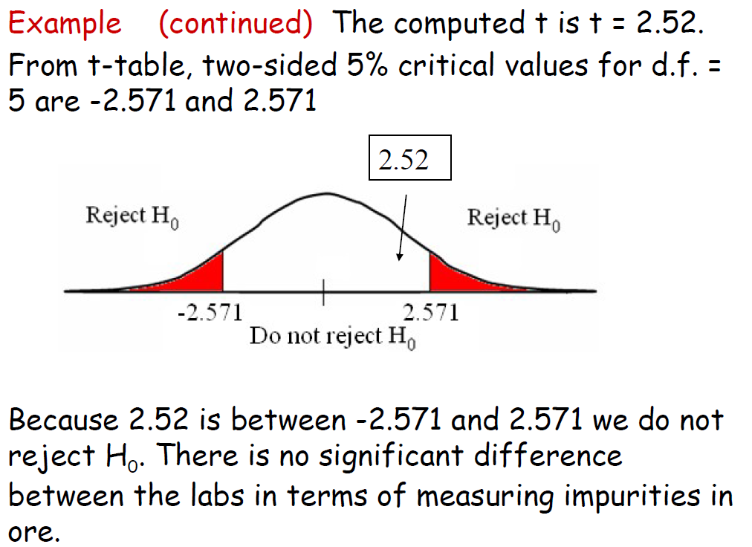

Slide 34
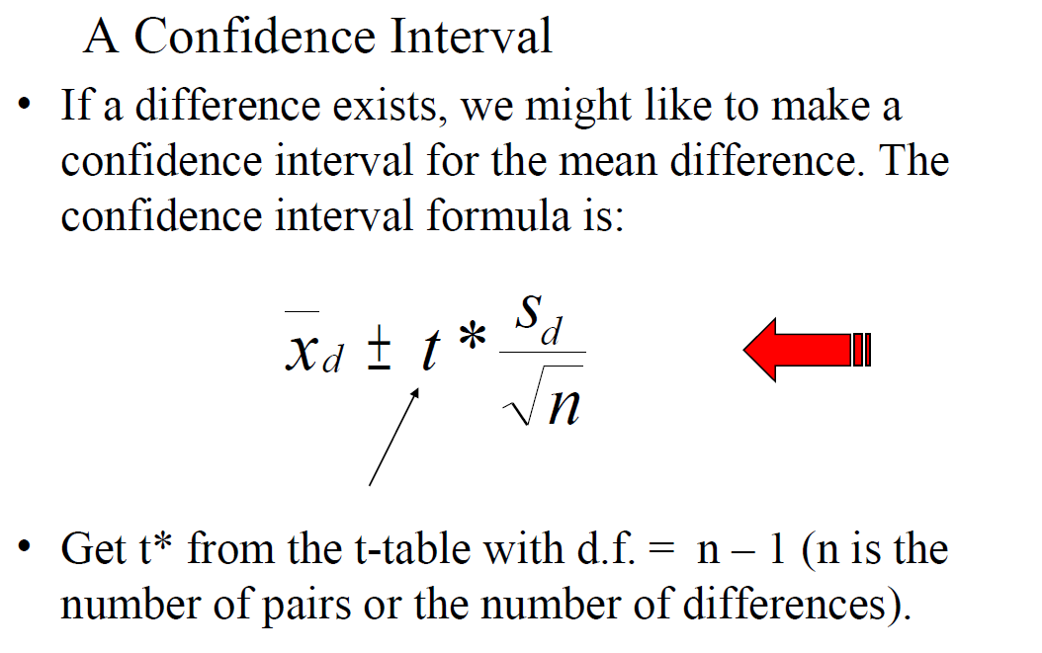

Slide 35
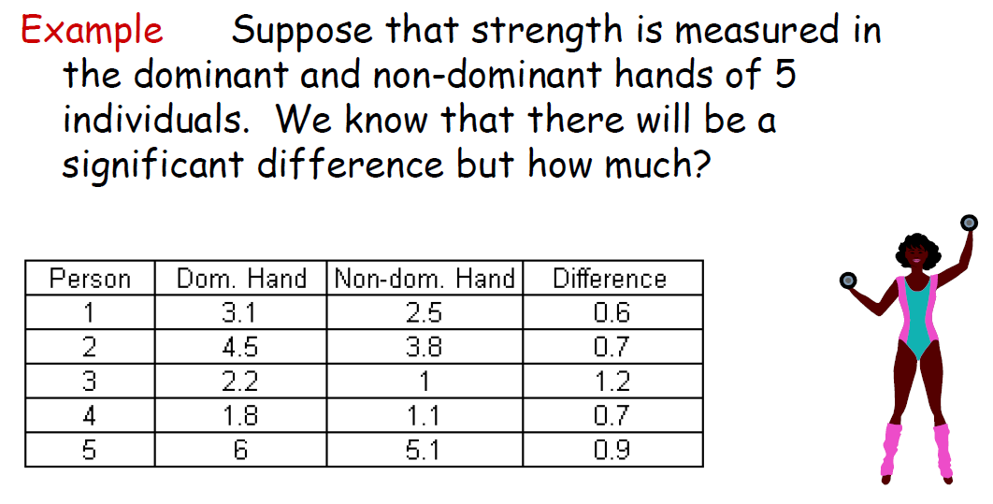

Slide 36
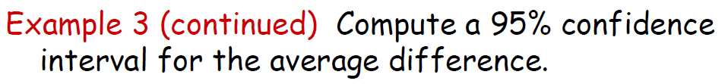

Slide 37
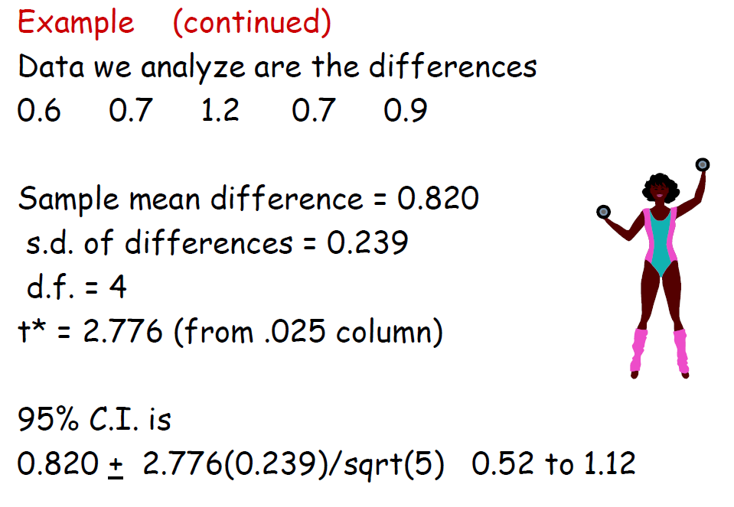

Slide 38
Example of matched pairs
Does a full moon affect behavior?
Many people believe that the moon influences the actions
of some individuals. A study of dementia patients in
nursing homes recorded various types of disruptive behaviors
every day for 12 weeks. Days were classified as moon days
if they were in a three-day period centered at the day of
the full moon. For each patient the average number of
disruptive behaviors was computed for moon days and
for other days.
Do a hypothesis test to assess whether there is a difference
in aggressive behaviors on moon days versus other days.
Patient aggmoon aggother aggdiff
1 3.33 0.27 3.06
2 3.67 0.59 3.08
3 2.67 0.32 2.35
4 3.33 0.19 3.14
5 3.33 1.26 2.07
6 3.67 0.11 3.56
7 4.67 0.30 4.37
8 2.67 0.40 2.27
9 6.00 1.59 4.41
10 4.33 0.60 3.73
11 3.33 0.65 2.68
12 0.67 0.69 -0.02
13 1.33 1.26 0.07
14 0.33 0.23 0.10
15 2.00 0.38 1.62

Slide 39
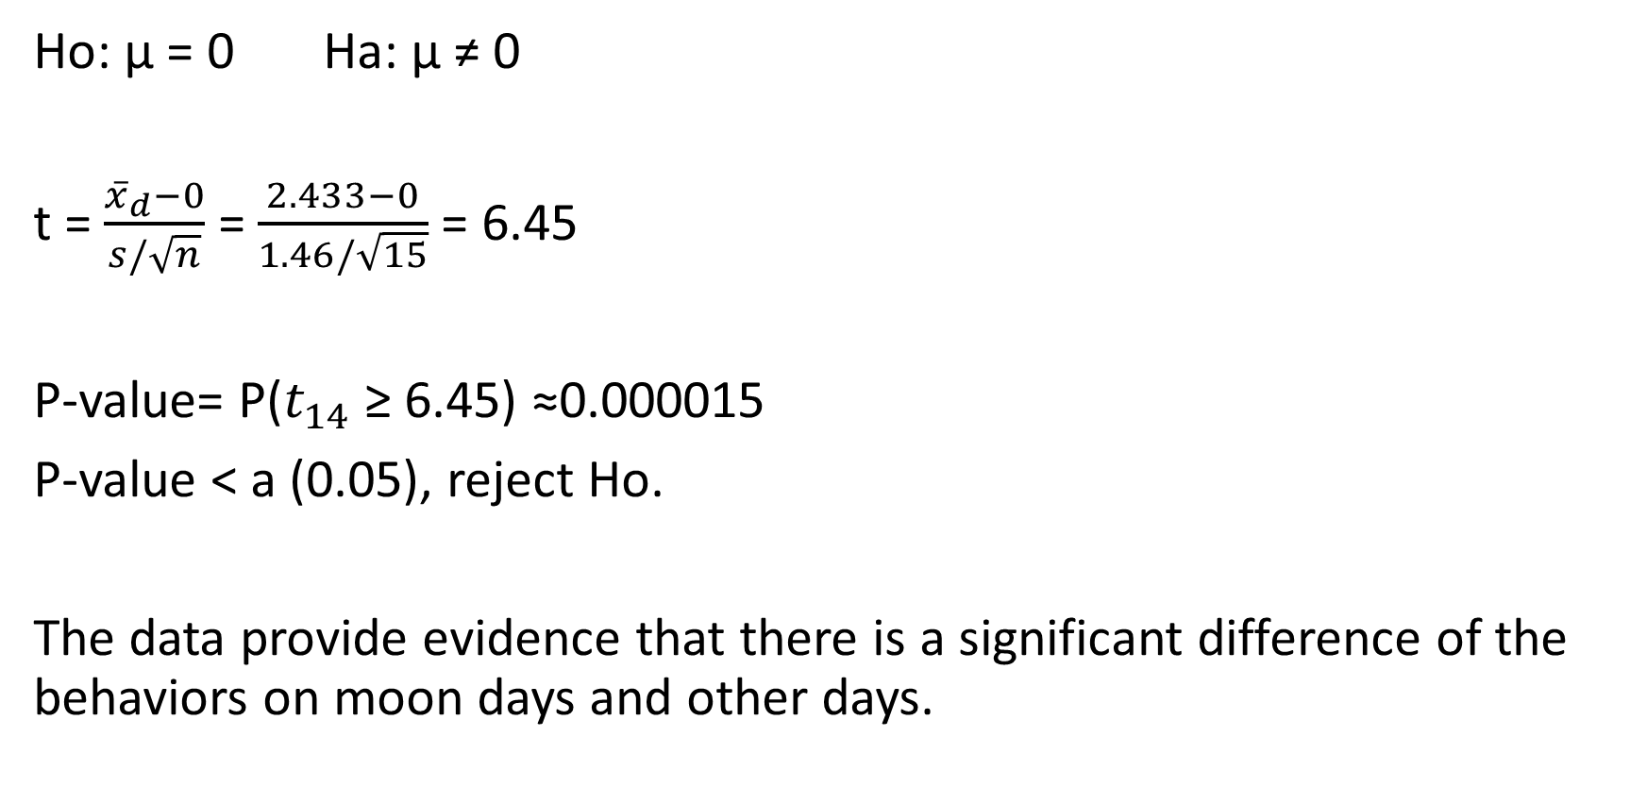
Example continued
Ho: μ = 0 Ha: μ ≠ 0
t = $\frac{{\overline{x}}_{d}−0}{s/\sqrt{n}}$ = $\frac{2.433−0}{1.46/\sqrt{15}}$ = 6.45
P-value= P($t_{14}$ ≥ 6.45) ≈0.000015
P-value < a (0.05), reject Ho.
The data provide evidence that there is a significant difference of the behaviors on moon days and other days.

Slide 40
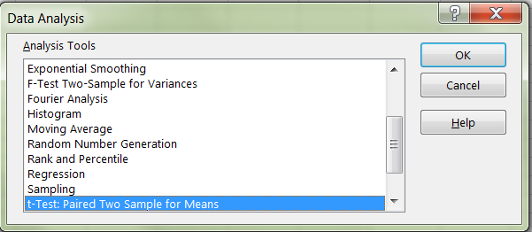
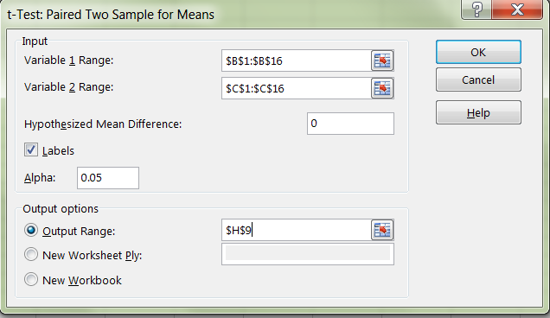
Excel result
Data→ data analysis
→t-test: paired two sample
for means
→fill in the two variable ranges
and output range

Slide 42
One-Sample t Confidence Interval
The one-sample t interval for a population mean is similar in both reasoning and computational detail to the one-sample z interval for a population mean.
The One-Sample t Interval for a Population Mean
Choose an SRS of size n from a population having unknown mean µ. A level C confidence interval for µ is
where t* is the critical value for the t(n – 1) distribution.
The margin of error is
This interval is exact when the population distribution is Normal and approximately correct for large n in other cases.

Slide 43
7.2 Comparing Two Means
The two-sample t procedures
The two-sample t confidence interval
The two-sample t significance test
The pooled two-sample t procedures

Slide 44
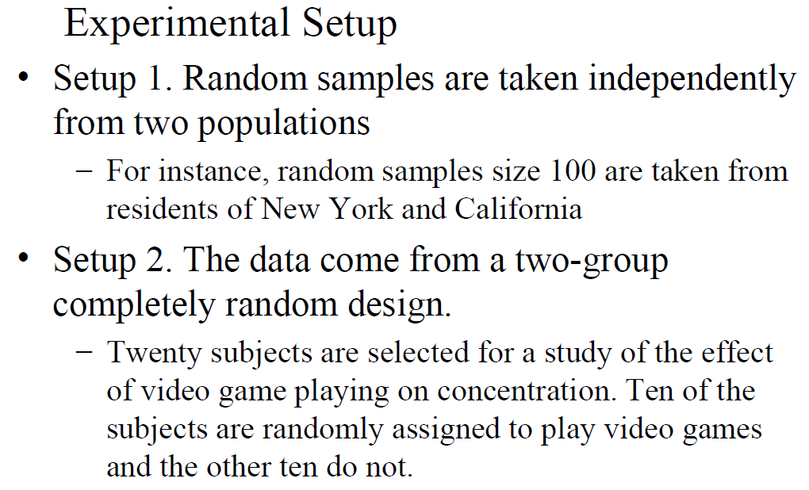

Slide 45
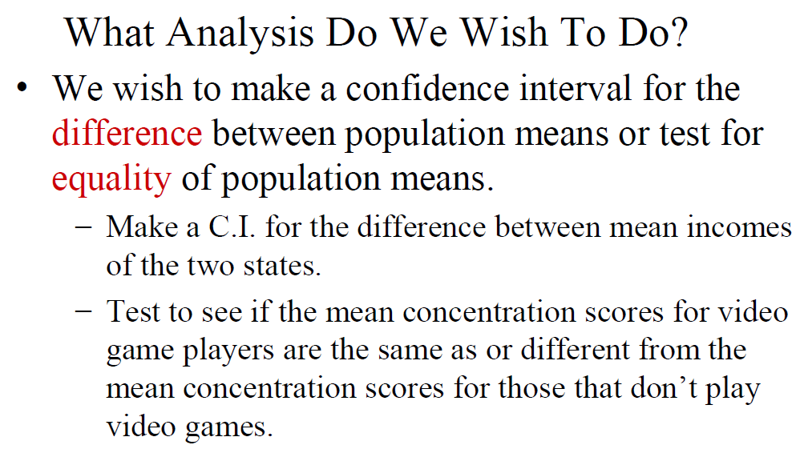

Slide 46
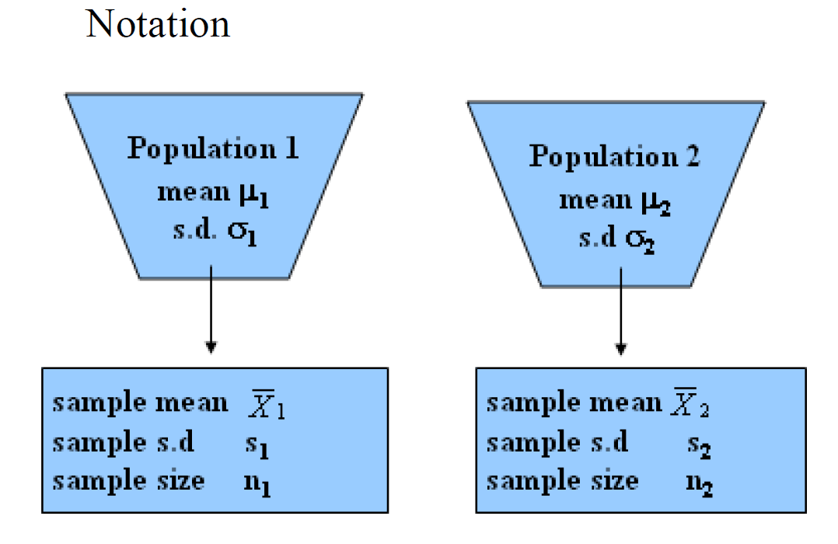

Slide 47
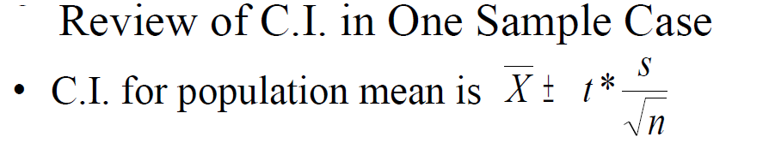
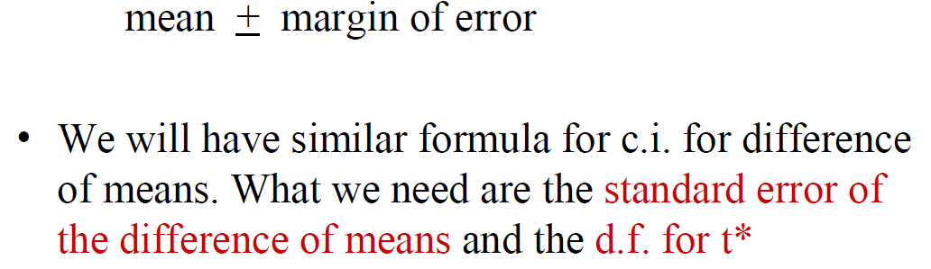

Slide 48
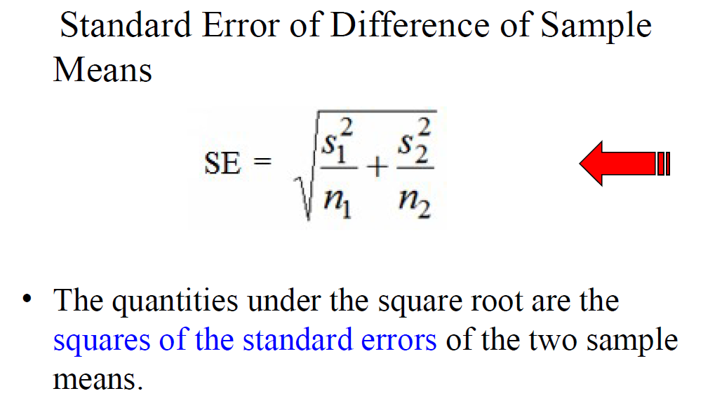

Slide 49
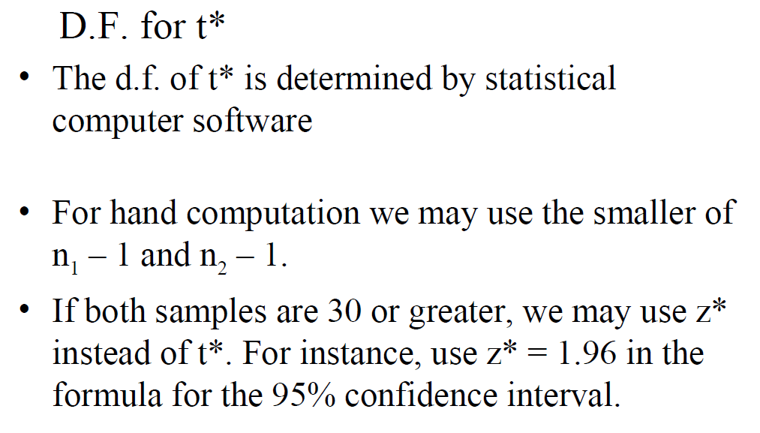

Slide 50
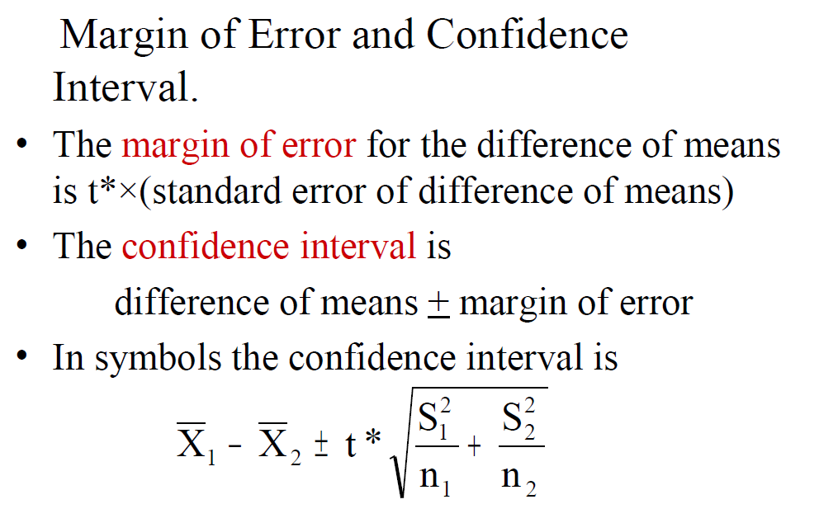

Slide 51
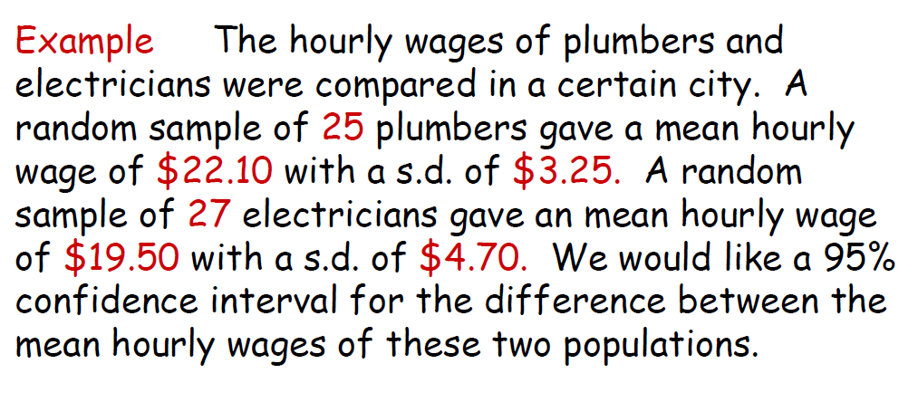

Slide 52
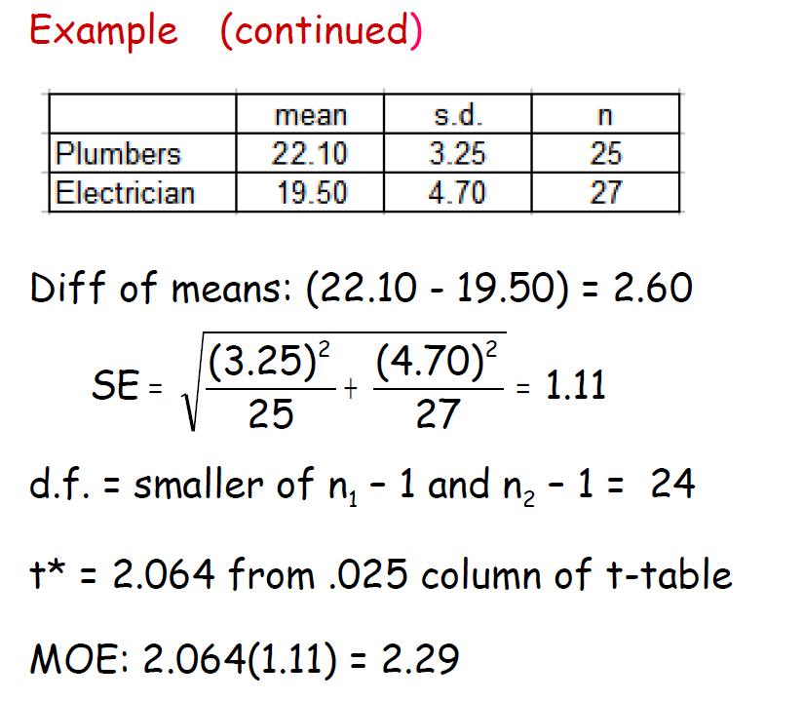

Slide 53
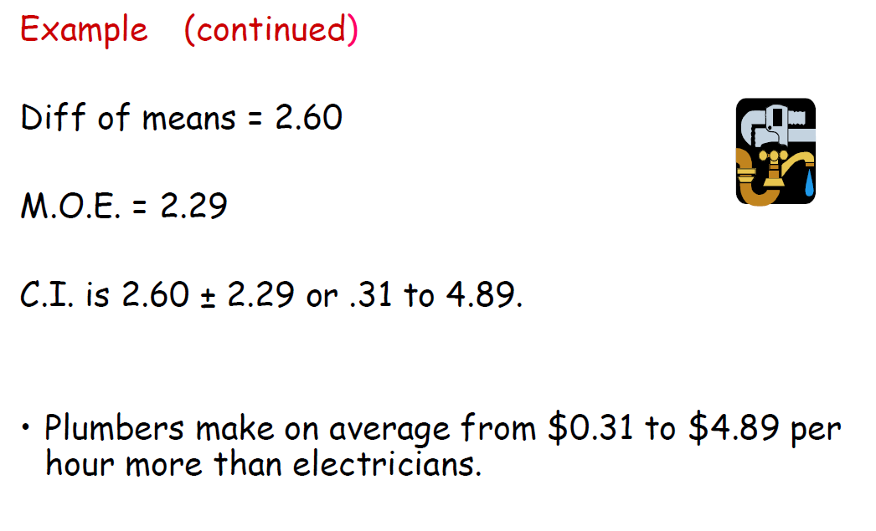

Slide 54
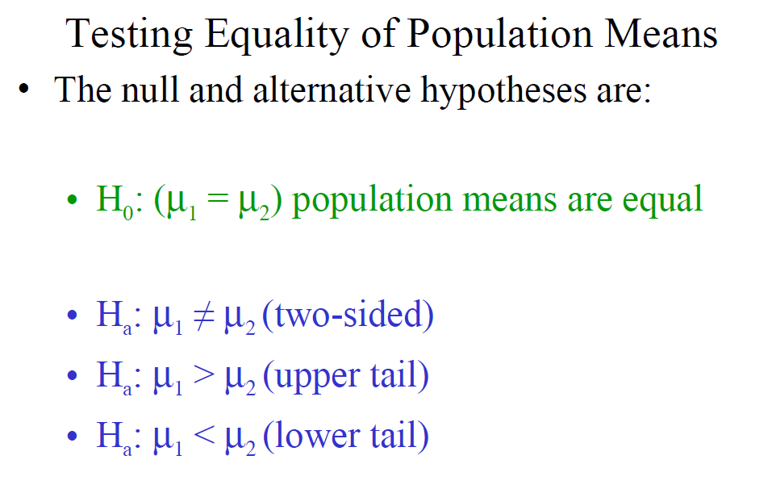

Slide 55
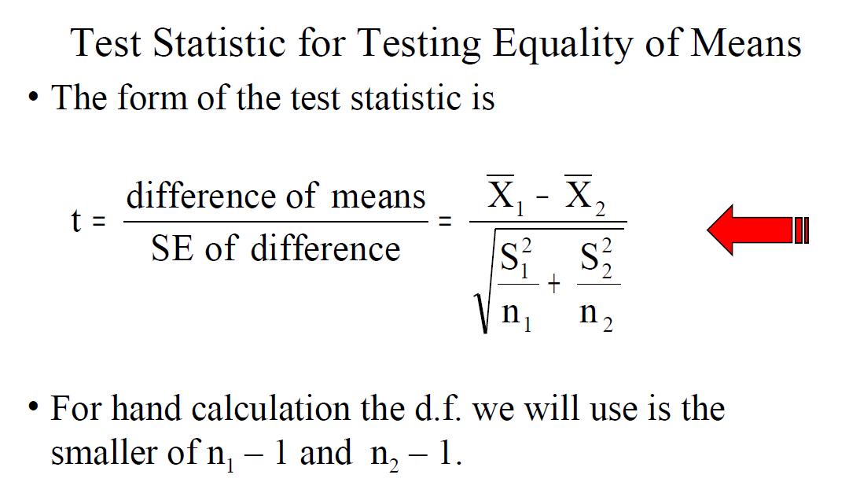

Slide 56
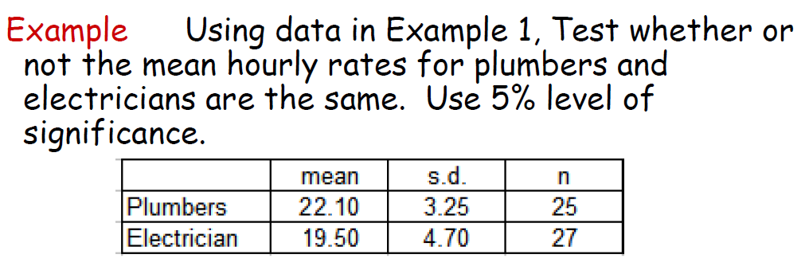

Slide 57


Slide 58
Example of two sample t-test
Example: Calcium and blood pressure.
Examination of a large sample of people
revealed a relationship between calcium
intake and blood pressure. A randomized
comparative experiment gave one group
of 10 men a calcium supplement for 12 weeks.
The control group of other 11 men received
a placebo that appeared identical.

Slide 59

Excel result
Click data→data analysis
→

Slide 60

Pooled Two-Sample Procedures
There are two versions of the two-sample t-test: one assuming equal variance (“pooled two-sample test”) and one not assuming equal variance (“unequal” variance, as we have studied) for the two populations. They have slightly different formulas and degrees of freedom.
The pooled (equal variance) two-sample t-test was often used before computers because it has exactly the t distribution for degrees of freedom n₁ + n₂ − 2.
However, the assumption of equal variances is difficult to check; thus, the unequal variance test is safer.
Two Normally distributed populations with unequal variances

Slide 61


Slide 62
Example
Does increasing the amount of calcium in our diet reduce blood pressure? A randomized comparative experiment gave one group of 10 black men a calcium supplement for 12 weeks and a control group of 11 black men a placebo that appeared identical. The summary statistics are given below for the decreases in blood pressure.
Group | n | Mean | s
Calcium | 10 | 5.000 | 8.743
Placebo | 11 | -.273 | 5.901
To test the hypothesis H₀: µ₁ = µ₂ against a one-sided or a two-sided alternative, compute the pooled two-sample t statistic for the t(n₁ + n₂ − 2) distribution.
The P-value from statistical software is p = 0.059, and we conclude that there is some evidence but not convincing evidence.

Slide 63
Example of two sample t-test
Example: Calcium and blood pressure.
Examination of a large sample of people
revealed a relationship between calcium
intake and blood pressure. A randomized
comparative experiment gave one group
of 10 men a calcium supplement for 12 weeks.
The control group of other 11 men received
a placebo that appeared identical.

Slide 64
Excel result of Calcium and blood Pressure Assuming equal variance

